Slide 1

Tutorial 6: IO Operations
COMP 249 CCCE
Object-Oriented Programming II

Slide 2
Tasks
Exception Handling Review
IO

Slide 3
Try/Catch block & Finally
try
{
//code
//more code
//more code
}
catch (ExceptionType e)
{
//handler for this type
}
finally{
//Executes always
}
Exception is an event, which occurs during the execution of a program, that disrupts the normal flow of the program's instructions.
The try block allows you to define code to be tested for errors while it is being executed.
The catch block allows you to define code to be executed, if an error occurs in the try block.
There can be multiple catch blocks to catch multiple exceptions
The code in the finally block executes no matter if of an exception was caught or not
There is a problem where code in finally block can overwrites the code from try or catch blocks

Slide 4
Throw an Exception
// Use of unchecked Exception
try {
// double x=3/0;
throw new ArithmeticException();
}
catch (ArithmeticException e)
{
//log of method calls of e
e.printStackTrace();
}
The throw keyword is used to throw an exception
The throws is used for declaring that a method may throw exception (written in the signature of the method)
When a method throws an exception, you are declaring that this method may throw an exception that it does not handle. This shifts the responsibility of handling the exception to the JVM, which will print the stack trace of the exception to the standard error stream if an exception is thrown and not caught within the method
When an exception is thrown and not caught within a method that declares throws Exception, the exception is propagated up the call stack (from method that occurred to method that called)

Slide 5





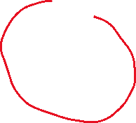

Example with methods
public class StackTraceExample {
public static void main(String[] args) {
try {
method1();
} catch (Exception e) {
e.printStackTrace();
}
}
public static void method1() throws Exception {
method2();
}
public static void method2() throws Exception {
method3();
}
public static void method3() throws Exception {
throw new Exception("An error occurred in method3");
}
}

Slide 6
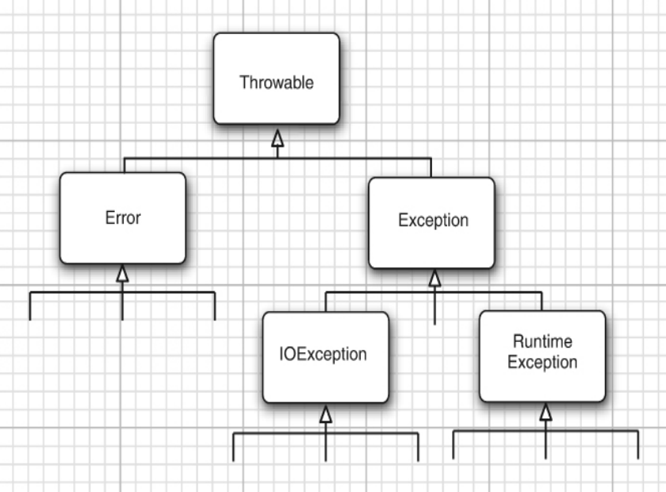



Exception Hierarchy & Checked/Unchecked Exceptions
Core Java Volume I: Fundamentals
Checked exception must be handle by try/catch block (compiler forces you to do it)
Unchecked exception are not compulsory to be handled
class IOException is the root class for various exception classes having to do with input and output
You can define your own exception:
class MyOwnException extends Exception{}
classNotFoundException
IOException
InterruptedException
NumberFormatException
RuntimeException
ArithmeticException (/ by 0)
NullPointerException (reference to null)

Slide 7
Working with Files
We need java.io* and java.util.Scanner packages
To operate on files, we can create an object of class File
Useful methods :
createNewfile()
delete()
exists();
getAbsolutePath();
mkdir()
list()
To write to file, we use FileWriter class
To read from file, we use Scanner class
*Code Example: Tutorial7_Examples

Slide 8
BufferedReader
Buffer is a temporary memory area that holds the data
We instantiate BufferedReader class and use readLine keyword to read from file
We instantiate BufferedWriter class and use write keyword to write to file
Java offers multiple ways to perform file operations because each approach has its strengths and is designed to cater to different needs and use cases.
*Code Example: Tutorial_7

Slide 9
Serialization
Serialization is the process of turning an data structure or object such that it may be stored or transmitted, then reconstructed to its previous state later
In Java, you can make objects of a class serializable by having that class implement the Serializable interface. Serializable doesn’t have any methods or fields to be implemented, it just marks that class as Serializable. You can then serialize and deserialize objects of that class using an ObjectOutputStream and an ObjectInputStream, respectively

Slide 10
References
https://www.w3schools.com/java/java_files.asp
Learn JAVA Programming – Beginner to Master
https://www.udemy.com/course/java-se-programming/?couponCode=LETSLEARNNOWPP
Ella Noyes’ slides

Slide 11
Happy Coding!

